Slide 1

Part A: Object-Oriented Design
Design Principles
Abu Saleh Musa Miah (PhD)
Notes:
Design Principles: Additional design principles will help you to create code that is flexible, reusable, and maintainable. You will learn about coupling and cohesion, separation of concerns, information hiding, and conceptual integrity. You will also learn to avoid common pitfalls with inheritance, and ways to express software behavior in UML

Slide 2
Presentation Outline
Design Principle
Evaluating Design Complexity

Slide 3


Design Principles
Provides guidelines for evaluating software structure
Ensures software is flexible, reusable, and maintainable
Covers behavior modeling using:
  UML State Diagrams
  UML Sequence Diagrams
Evaluating Design Complexity
  Keep modules simple to avoid unnecessary complexity
  Excessive complexity → harder to understand → more bugs
  Evaluation of design complexity is essential for quality assurance
  Complexity applies to:
    Classes
    Methods within classes
  In this module, "module" = program unit containing classes and methods

Slide 4
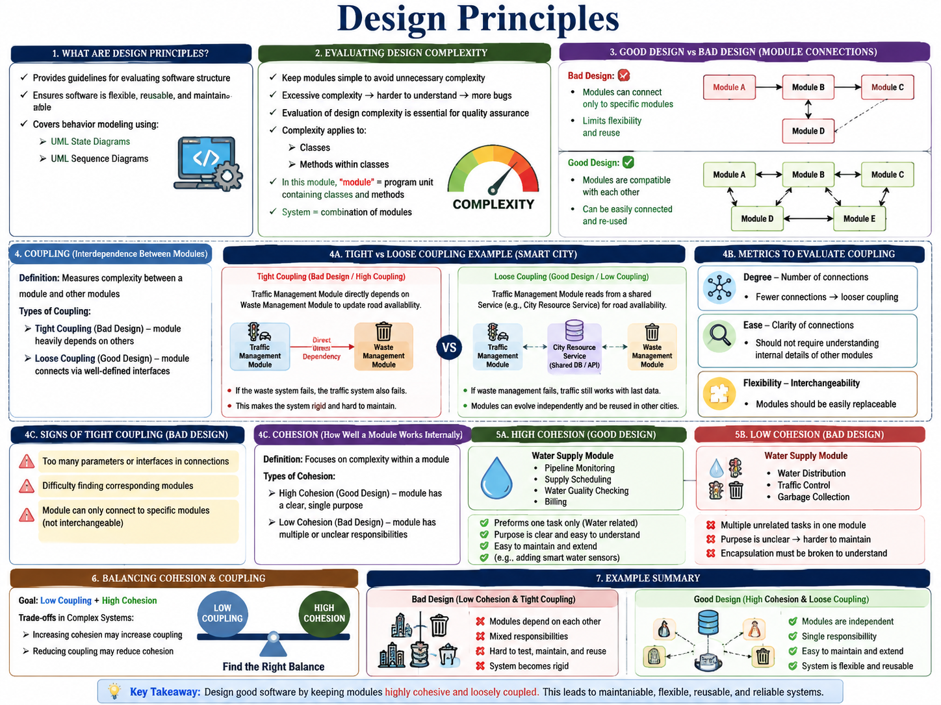
Design Principles
Provides guidelines for evaluating software structure
Ensures software is flexible, reusable, and maintainable
Covers behavior modeling using:
  UML State Diagrams
  UML Sequence Diagrams
Evaluating Design Complexity
  Keep modules simple to avoid unnecessary complexity
  Excessive complexity → harder to understand → more bugs
  Evaluation of design complexity is essential for quality assurance
  Complexity applies to:
    Classes
    Methods within classes
  In this module, "module" = program unit containing classes and methods

Slide 5
System Design & Module Interaction
System = combination of modules
Bad design:
  Modules can connect only to specific modules
  Limits flexibility and reuse
Good design:
  Modules are compatible with each other
  Can be easily connected and re-used
Evaluating Design Complexity
  Coupling (Interdependence between modules)– degree of interdependence between modules
  Cohesion (How well a single module works internally)– degree to which elements within a module work together

Slide 6
Coupling in Software Design
Definition: Measures complexity between a module and other modules
Types of Coupling:
  Tight Coupling (Bad Design) – module heavily depends on others
  Loose Coupling (Good Design) – module connects via well-defined interfaces
Metrics to Evaluate Coupling
Degree – number of connections
  Fewer connections → looser coupling
Ease – clarity of connections
  Should not require understanding internal details of other modules
Flexibility – interchangeability
  Modules should be easily replaceable
Signs of Tight Coupling (Bad Design)
Too many parameters or interfaces in connections
Difficulty finding corresponding modules
Module can only connect to specific modules (not interchangeable)

Slide 7
Coupling (Interdependence between modules)
Tight Coupling (Bad Design/ High Coupling):
Suppose the Traffic Management Module directly depends on the Waste Management Module to update road availability. For example, traffic routes can only be updated if the waste collection module first finishes its update.
  If the waste system fails, the traffic system also fails.
  This makes the system rigid and hard to maintain.
Loose Coupling (Good Design/Low Coupling):
The Traffic Management Module just reads from a shared database or service (e.g., a central “City Resource Service”) that contains road availability. The Waste Management Module also updates the same database, but they don’t directly depend on each other.
  If waste management fails, traffic still works with the last available data.
  Modules can evolve independently and be reused in other cities.

Slide 8
Cohesion in Software Design
Definition: Focuses on complexity within a module
Types of Cohesion:
  High Cohesion (Good Design) – module has a clear, single purpose
  Low Cohesion (Bad Design) – module has multiple or unclear responsibilities
Characteristics
  High Cohesion:
    Module performs one task only
    Purpose is clear and easy to understand
  Low Cohesion:
    Module performs multiple unrelated tasks
    Purpose is unclear → harder to maintain
    Encapsulation must be broken to understand

Slide 9
Cohesion in Software Design
Balancing Cohesion & Coupling
  Goal: Low Coupling + High Cohesion
  Trade-offs in Complex Systems:
    Increasing cohesion may increase coupling
    Reducing coupling may reduce cohesion

Slide 10
Cohesion in Software Design
Bad Design (Low Cohesion):
The Water Supply Module not only distributes water but also contains code for traffic control and garbage collection.
  Responsibilities are mixed.
  Hard to test, maintain, or reuse.
Good Design (High Cohesion):
The Water Supply Module only handles tasks related to water: pipeline monitoring, supply scheduling, water quality checking, and billing.
  Single responsibility.
  Easy to maintain and extend (e.g., adding smart water sensors).

Slide 11
Coupling Cohesion Example-1
Scenario-1: Suppose we have a class called FarmController in the Automated Agricultural System that has two purposes: controlling irrigation and fertilizer dispensing. Here we have a controlSystem() method that takes a zero (0) flag if you want to activate the irrigation system, and takes the one (1) flag if you want to activate the fertilizer system. The class diagram for the FarmController and implementation of its controlSystem() method is as below:
FarmController + controlSystem(controlFlag: int) | public void controlSystem(int controlFlag) { switch (controlFlag) { case 0: return this.startIrrigation(); case 1: return this.startFertilizerDispense(); default: throw new UnknownControlFlagException(); }}
Problem a): Evaluate the above design in terms of coupling and cohesion. Give justification in each case.
Problem b): Suggest a better design for the above class that meets acceptable coupling and cohesion requirements.

Slide 12
Coupling Cohesion Example-1
Evaluation of the Current Design
Cohesion: Low Cohesion (Poor Design)- The FarmController class is responsible for two unrelated tasks:
  starting irrigation, and
  starting fertilizer dispensing.
Both actions belong to different subsystems of the agricultural system, yet they are handled in a single method (controlSystem()), which switches behavior via flags. This leads to low cohesion because:
  The class performs multiple independent functions, violating the Single Responsibility Principle (SRP).
  The controlSystem() method does more than one job, decided by a control flag (0 or 1).
  If future systems (e.g., pest-control, greenhouse ventilation) are added, the class must be modified repeatedly, further reducing cohesion.
  Thus, the class is not focused on one responsibility, making it difficult to maintain and extend.
Coupling: Higher Than Necessary (Flag-Based Coupling)- While the class itself may not depend on many external components, the internal coupling is unnecessarily strong:
  The class knows the internal details of both irrigation and fertilizer systems.
  Changing the logic of either subsystem would force modifications inside FarmController.
  Using numeric flags (0 and 1) introduces implicit, error-prone coupling—only the sender of the flag knows what the values mean.
  External components that call controlSystem(flag) must also depend on the meaning of those numbers, creating a hidden dependency.
This design leads to tighter coupling and reduces flexibility.

Slide 13
Coupling Cohesion Example-1
b) Suggested Improved Design (Better Cohesion & Lower Coupling)
To achieve a clean design, the responsibilities should be separated into their own classes, and FarmController should act only as a coordinator.
Better Design Structure
  1. IrrigationController Class
    Handles all irrigation-related operations.
    Highly cohesive: one responsibility.
  2. FertilizerController Class
    Responsible only for fertilizer dispensing.
    Highly cohesive.
  3 FarmController Class
    Coordinates actions by calling the appropriate controller.
    Low coupling: interacts with controllers through clean
    method calls—not numeric flags.
+----------------------+
| FarmController |
+----------------------+
| - irrigationCtrl |
| - fertilizerCtrl |
+----------------------+
| + activateIrrigation() |
| + activateFertilizer() |
+------------+--------------+
|
----------------------
| |
v v
+------------------+ +------------------------+
| IrrigationCtrl | | FertilizerController |
+------------------+ +------------------------+
| + startIrrigation() | | + startDispensing() |
+------------------+ +------------------------+
Figure: Improved UML-Style Diagram

Slide 14
Coupling Cohesion Example-1
Improved Code Example
Why This Design Is Better
High Cohesion
  Each class has one dedicated purpose.
  Easier to update and test.
Low Coupling
  FarmController does not know internal details of each subsystem.
  New systems can be added (e.g., pestControl) by creating new classes without changing existing ones.
Readable and Maintainable
  Method names clearly describe actions.
  Eliminates confusing flag-based logic.
public class FarmController {
private IrrigationController irrigationCtrl;
private FertilizerController fertilizerCtrl;
public FarmController() {
this.irrigationCtrl = new IrrigationController();
this.fertilizerCtrl = new FertilizerController();
}
public void activateIrrigation() {
irrigationCtrl.startIrrigation();
}
public void activateFertilizer() {
fertilizerCtrl.startDispensing();
}
}
Figure: Improved Code
Advantage of the code: No flags, No switch statements., Clear responsibilities.
Notes:
Advantage: No flags.
No switch statements.
Clear responsibilities.

Slide 15
Coupling Cohesion Example-2
Scenario-2: Suppose we have a class called ServiceManager in the Dhaka Urban Management System that has two purposes: handling waste collection requests and road maintenance requests.
Here we have a processRequest() method that takes a zero (0) flag if we want to process a waste collection request, and takes the one (1) flag if we want to process a road maintenance request. The class diagram for the ServiceManager and implementation of its processRequest() method is as below:
ServiceManager + processRequest(controlFlag: int) | public void processRequest(int controlFlag) { switch (controlFlag) { case 0: return this.handleWasteCollection(); case 1: return this.handleRoadMaintenance(); default: throw new UnknownControlFlagException(); }}
Evaluate the above design in terms of coupling and cohesion. Give justification in each case.
Suggest a better design for the above class that meets acceptable coupling and cohesion requirements.

Slide 16
Separation of Concerns (SoC)
One of the design principles examined in the previous module was that of decomposition.
Decomposition divides a whole into different parts. To understand why decomposition is necessary in design, the principle of separation of concerns must be examined.
Separation of Concerns (SoC)
  Definition: Dividing a system into distinct parts, each addressing a separate concern
  Concern: Anything that matters in solving a problem (e.g., data, logic, presentation)
  Goal: Keep concerns separate and organized in design and implementation
A concern is a very general notion: it is anything that matters in providing a solution to a problem. Separation of concerns is about keeping the different concerns in your design separate.
When software is designed, different concerns should be addressed in different portions of the software.

Slide 17
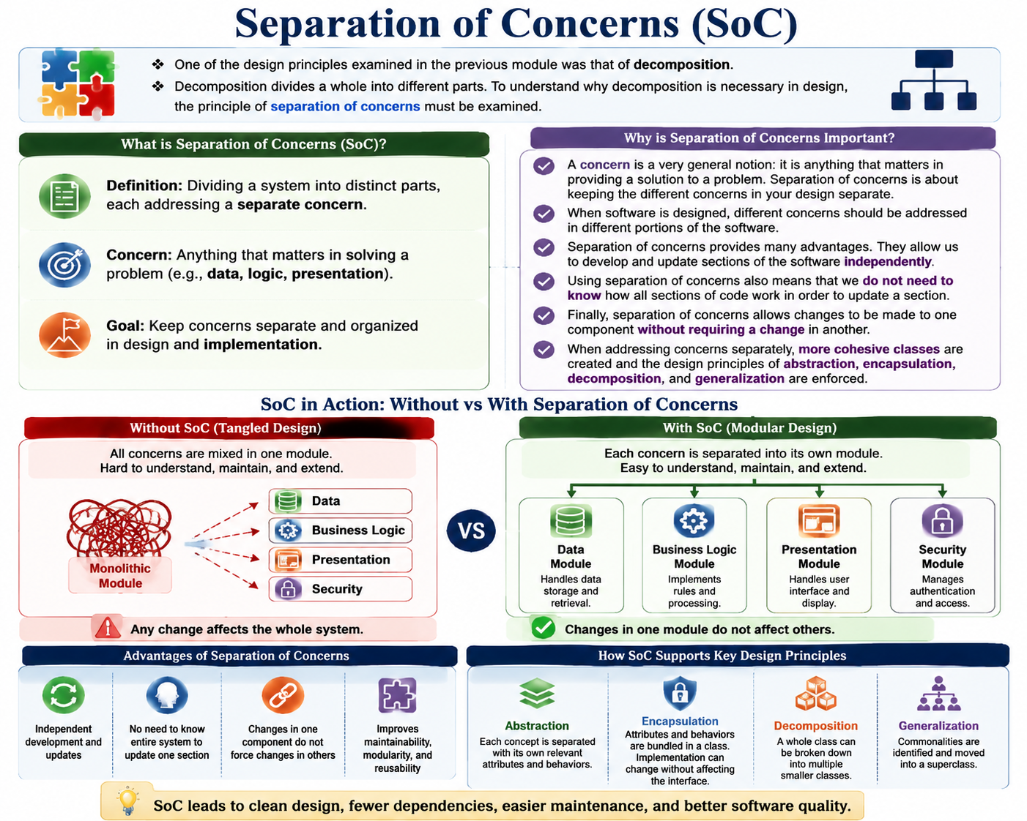
Separation of Concerns (SoC)
One of the design principles examined in the previous module was that of decomposition.
Decomposition divides a whole into different parts. To understand why decomposition is necessary in design, the principle of separation of concerns must be examined.
Separation of Concerns (SoC)
  Definition: Dividing a system into distinct parts, each addressing a separate concern
  Concern: Anything that matters in solving a problem (e.g., data, logic, presentation)
  Goal: Keep concerns separate and organized in design and implementation
A concern is a very general notion: it is anything that matters in providing a solution to a problem. Separation of concerns is about keeping the different concerns in your design separate.
When software is designed, different concerns should be addressed in different portions of the software.

Slide 18
Separation of Concerns (SoC)
Separation of concerns provides many advantages. They allow us to develop and update sections of the software independently.
Using separation of concerns also means that we do not need to know how all sections of code work in order to update a section.
Finally, separation of concerns allows changes to be made to one component without requiring a change in another.
When addressing concerns separately, more cohesive classes are created and the design principles of abstraction, encapsulation, decomposition, and generalization are enforced
Advantages of SoC
Abstraction occurs as each concept in the problem space is separated with its own relevant attributes and behaviors.
Encapsulation occurs as the attributes and behaviors are gathered into their own section of code called a class. Access to the class from the rest of the system and its implementation are separated, so details of implementation can change while the view through an interface can stay the same.

Slide 19
Separation of Concerns (SoC)
Advantages of SoC
  Decomposition occurs as a whole class can be separated into multiple classes.
  Generalization occurs as commonalities are recognized and subsequently separated and generalized into a superclass.
  Independent development and updates of software sections
  No need-to-know entire system to update one section
  Changes in one component do not force changes in others
  Improves maintainability, modularity, and reusability

Slide 20
Separation of Concerns Example
Consider a smartphone capable of many behaviors:
  taking photos,
  scheduling meetings,
  sending and receiving email,
  browsing the Internet,
  sending texts, and
  making phone calls.
This example will only focus on two functions camera and traditional phone functions.

Slide 21
Separation of Concerns Example
This example will only focus on two functions camera and traditional phone functions.
public class SmartPhone {
private byte camera;
private byte phone;
public SmartPhone() { … }
public void takePhoto() { … }
public void savePhoto() { … }
public void cameraFlash() { … }
public void makePhoneCall() { … }
public void encryptOutgoingSound() { … }
public void decipherIncomingSound() { … } }
This code has a SmartPhone class with attributes called camera and phone, and associated behaviors.
This system has low cohesion, as there are behaviors that are not related to each other.
The camera behaviors do not need to be encapsulated with the behaviors of the phone in order for the camera to do its job.
The components also do not offer modularity.

Slide 22
Separation of Concerns Example
For example, it is not possible to access the camera or the phone separately if another system is built that requires only one or the other.
The camera also would not be able to be replaced with a different camera, or even a different object, without removing the code for the camera completely from this class.
The SmartPhone class needs to be more cohesive, and each component of the smartphone should have distinctive functionality.
Using the separation of concerns, we can identify that the SmartPhone class has two concerns:
  To act as a traditional telephone.
  To take pictures using the built-in camera.
With the concerns identified, it is possible to separate them into their own more cohesive classes and encapsulate all the details about each concern into functionally distinct and independent classes.

Slide 23
Separation of Concerns Example
Problem: Low Cohesion in SmartPhone Class
  SmartPhone class mixes camera and phone functions
  Low cohesion: unrelated behaviors grouped together
  No modularity: cannot reuse/replace camera or phone independently
Solution: Separation of Concerns
  Identify two distinct concerns:
    Phone functionality
    Camera functionality
  Create separate cohesive classes: Phone and Camera
  SmartPhone acts as a coordinator, referencing both
  Improves:
    Cohesion (focused responsibilities)
    Modularity (components can be reused/replaced)

Slide 24
Separation of Concerns Example
The SmartPhone class will reference instances of the new classes so that the smartphone can act as a coordinator of the camera and the phone.
This will let our smartphone provide access to all the behaviours of the camera and the phone, without having to know how each component behaves.
Using a UML Class diagram, this is how the new design for the SmartPhone system might look:

Slide 25
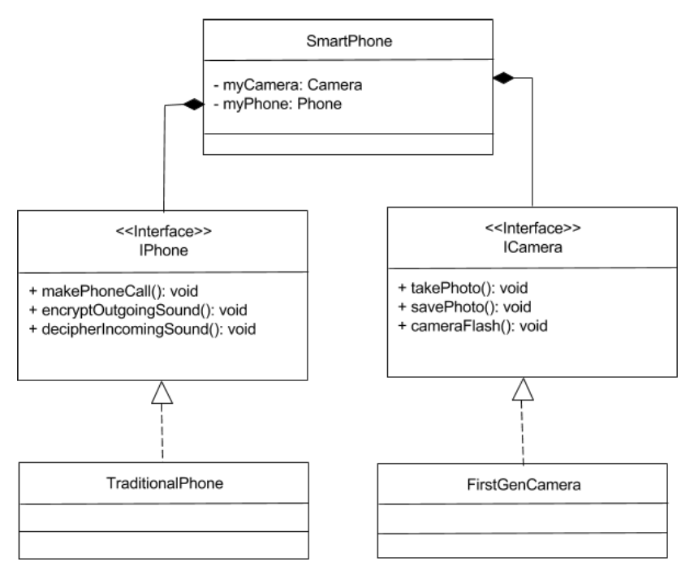
Example: Smartphone System
The code would translate as below:
public interface ICamera {
public void takePhoto();
public void savePhoto();
public void cameraFlash();
}
public interface IPhone {
public void makePhoneCall();
public void encryptOutgoingSound();
public void deciphereIncomingSound();
}
public class FirstGenCamera implements ICamera {
/* Abstracted camera attributes */
public class TraditionalPhone implements IPhone {
/* Abstracted phone attributes */
}
The attributes and behaviors for the phone and camera have been separated into two distinct interfaces. These are each implemented with a corresponding class. The code would translate as below:

Slide 26
Example: Smartphone System
The SmartPhone class also need to be redesigned for two separate classes:
public class SmartPhone {
private ICamera myCamera;
private IPhone myPhone;
public SmartPhone( ICamera aCamera, IPhone
          aPhone ) {
          this.myCamera = aCamera;
          this.myPhone = aPhone;
          }
public void useCamera() {
return this.myCamera.takePhoto();
}
public void usePhone() {
return this.myPhone.makePhoneCall();
}
}

Slide 27
Example: Smartphone System
Redesigned SmartPhone System
  SmartPhone aggregates Phone and Camera classes
  Constructor takes IPhone and ICamera objects as parameters
  SmartPhone forwards responsibilities to these objects
  Who creates the Phone/Camera objects → separate responsibility
Benefits of Redesign
  Modular design – phone/camera can be swapped without changing SmartPhone code
  High cohesion – Phone and Camera have clear, independent functionality
  Flexibility – supports future upgrades (e.g., new camera type)
Trade-off
  Increased coupling: SmartPhone depends on IPhone and ICamera interfaces
Use of Separation of Concerns
  Generalization – define IPhone and ICamera interfaces
  Abstraction & Encapsulation – implement separate Phone and Camera classes
  Decomposition – split smartphone into distinct, reusable parts

Slide 28
Example: Smartphone System
SmartPhone Class Redesign
  ConstructorIntegrates camera and phone functionalities.
  Keeps Camera and Phone classes separated (hidden from each other).
  Both are aggregated under the SmartPhone class.
Design
  SmartPhone constructor accepts a Camera and a Phone as parameters.
  New SmartPhone instances can be created by passing in objects implementing ICamera and IPhone interfaces.
Responsibility Separation
  Creation of appropriate Camera and Phone objects is handled outside the SmartPhone class.
  SmartPhone does not need to know how these objects are created.
Method Delegation
  SmartPhone methods forward responsibilities to the aggregated camera and phone objects.

Slide 29
Example: Smartphone System
Modular Design Benefits
  Camera or Phone classes can be swapped without modifying SmartPhone code.
  Only the instantiation of SmartPhone and its parts needs to change.
Cohesion & Coupling
  SmartPhone class is now more cohesive.
  However, coupling increases since SmartPhone depends on Camera and Phone interfaces (indirect dependency).
Separation of Concerns Applied
  Generalization → Separate notions of Camera and Phone via interfaces.
  Abstraction & Encapsulation → Define first-gen Camera and traditional Phone as implementing classes.
  Decomposition → Break down SmartPhone into constituent parts (camera + phone) separated from the whole.

Slide 30
Information Hiding in Software Design
Definition: Modules only access the information needed to do their job
Purpose: Hide details that may change (algorithms, data representations)
Information hiding is commonly associated with sensitive data —the more sensitive the data, the more likely it should have limited access.
Assumptions: Exposed via APIs & interfaces
Benefits of Information Hiding
  Developers can work independently on modules
  Reduces dependencies on implementation details
  Flexibility: implementation can change without affecting others
  Security: sensitive data protected
  Reliability: prevents unwanted changes to critical attributes
Relation to Encapsulation
  Encapsulation: bundles attributes & behaviors into a class
  Provides access via interfaces
  Hides implementation details behind method signatures
  Allows internal changes without breaking external expectations

Slide 31
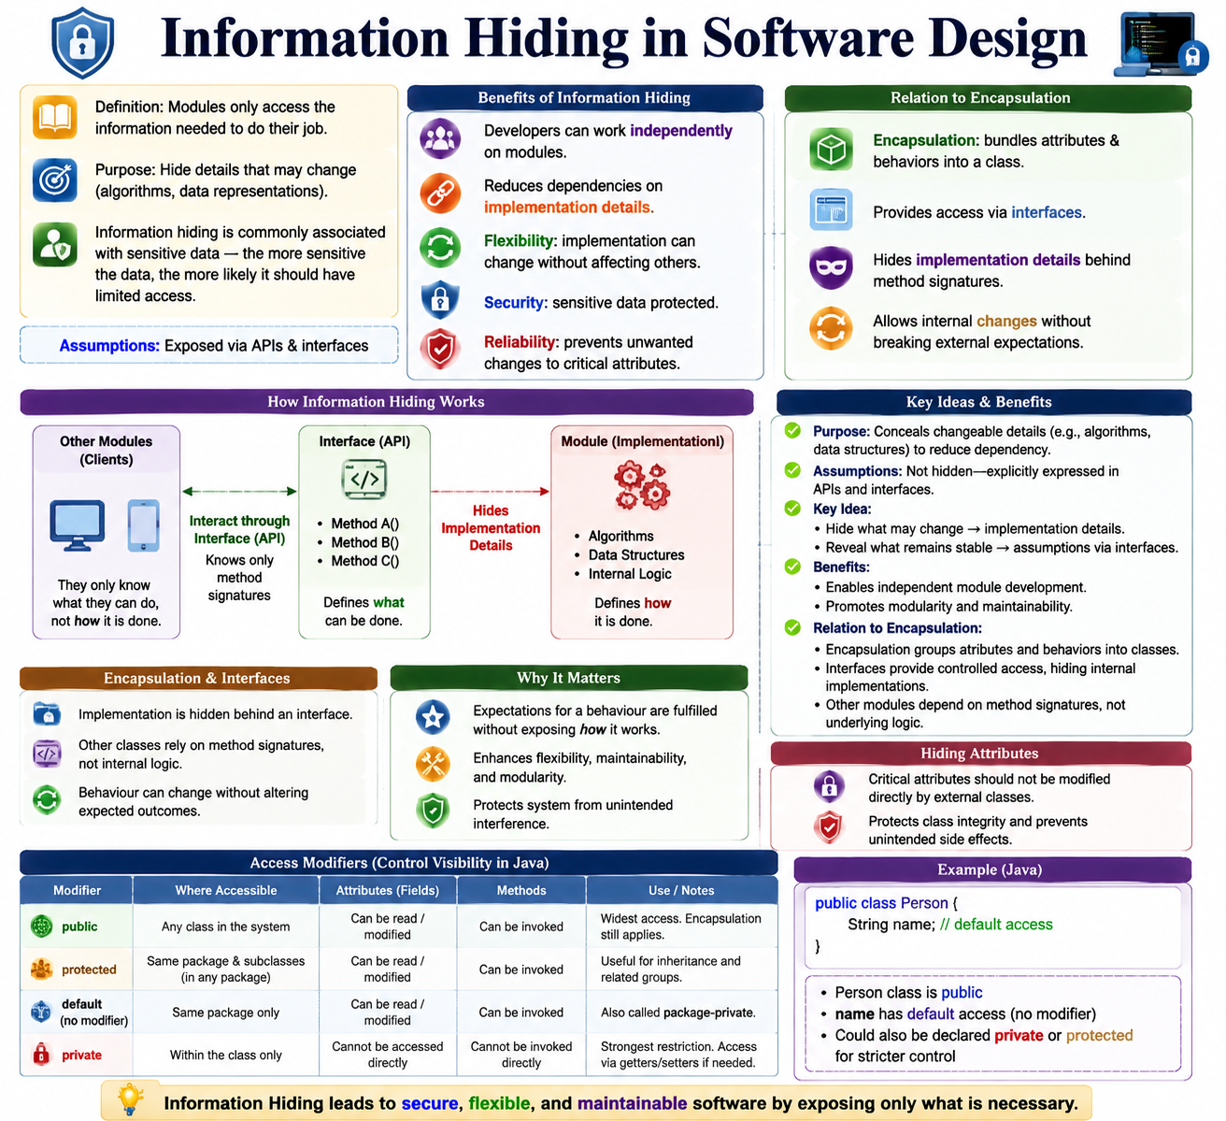

Slide 32
Information Hiding in Software Design
Purpose: Conceals changeable details (e.g., algorithms, data structures) to reduce dependency.
Assumptions: Not hidden—explicitly expressed in APIs and interfaces.
Key Idea:
  Hide what may change → implementation details.
  Reveal what remains stable → assumptions via interfaces.
Benefits:
  Enables independent module development.
  Promotes modularity and maintainability.
Relation to Encapsulation:
  Encapsulation groups attributes and behaviors into classes.
  Interfaces provide controlled access, hiding internal implementations.
  Other modules depend on method signatures, not underlying logic.

Slide 33
Information Hiding in Software Design
Encapsulation & Interfaces
  Implementation is hidden behind an interface.
  Other classes rely on method signatures, not internal logic.
  Behaviour can change without altering expected outcomes.
Why It Matters
  Expectations for a behaviour are fulfilled without exposing how it works.
  Enhances flexibility, maintainability, and modularity.
Hiding Attributes
  Critical attributes should not be modified directly by external classes.
  Protects class integrity and prevents unintended side effects.
Access Modifiers
  Control visibility of attributes and behaviours.
  Define what subclasses and other classes can access.
  Examples: public, private, protected.

Slide 34
Attributes & Access Modifiers (Java)
Attributes can be hidden to prevent direct external modification
Access levels:
  Public – Accessible everywhere
  Protected – Accessible within package & subclasses
  Default – Accessible within package only
  Private – Accessible within the class only
Public
  Accessible by any class in the system
  Attributes: Can be read/modified by other classes
  Methods: Can be invoked by other classes
  Encapsulation still applies → Implementation hidden
Protected
  Accessible by:
    The class itself
    Subclasses
    Same package classes
  Useful for inheritance and related groups of classes

Slide 35
Attributes & Access Modifiers (Java)
Default (No Modifier)
  Also called package-private
  Accessible only within the same package
  Not visible to subclasses outside the package
Private
  Accessible only within the class itself
  Attributes cannot be accessed directly by other classes
  Methods cannot be invoked by external classes
    public class Person {
    String name; // default access }
  Person class is public
  name has default access (no modifier)
  Could also be declared private or protected for stricter control

Slide 36
Conceptual Integrity in Software Design
Ensures a software system feels consistent and cohesive, as if guided by a single mind.
Maintains uniformity in design and implementation, even with multiple contributors.
How It’s Achieved:
  Clear design principles and conventions.
  Effective communication among team members.
  Regular code reviews for consistency.
  Unified architecture and design foundation.
  Adoption of common programming constructs.
  A small core group approving commits to ensure coherence.
Benefit:
  Produces software that is predictable, maintainable, and easier to understand.

Slide 37
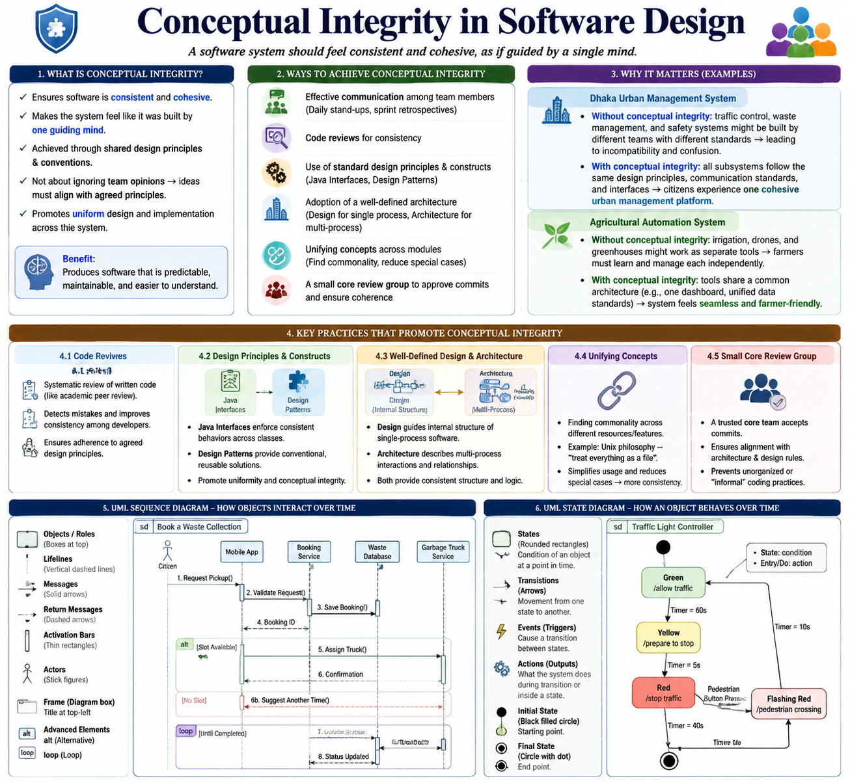

Slide 38
Conceptual Integrity in Software Design
Ensures software is consistent and cohesive
Makes the system feel like it was built by one guiding mind
Achieved through shared design principles & conventions
Not about ignoring team opinions → ideas must align with agreed principles
Promotes uniform design and implementation across the system
Ways to Achieve Conceptual Integrity
  Effective communication among team members
  Code reviews for consistency
  Use of standard design principles & constructs
  Adoption of a well-defined architecture
  Unifying concepts across modules
  A core review group to approve commits
Best Practice
  Agile practices: daily stand-ups & sprint retrospectives
  Agree on libraries, frameworks, and methods to ensure uniformity

Slide 39
Conceptual Integrity in Software Design
Dhaka Urban Management System & Conceptual Integrity
  If traffic control, waste management, safety, and citizen services are developed by different teams, the system could feel fragmented.
  Without conceptual integrity: traffic control, waste management, and safety systems might be built by different teams with different standards → leading to incompatibility and confusion.
  With conceptual integrity: all subsystems follow the same design principles, communication standards, and interfaces → citizens experience one cohesive urban management platform.
Agricultural Automation System & Conceptual Integrity
  Different modules (irrigation sensors, drones, greenhouses, AI models) are often developed separately.
  Without conceptual integrity: irrigation, drones, and greenhouses might work as separate tools → farmers must learn and manage each independently.
  With conceptual integrity: these tools share a common architecture (e.g., one dashboard, unified data standards), making the system feel seamless and farmer-friendly.
  Conceptual integrity ensures that complex systems—whether in urban management or agriculture—work as a unified whole, not just a collection of disconnected parts.

Slide 40
Conceptual Integrity – Key Practices
Code Reviews
  Systematic review of written code (like academic peer review)
  Detects mistakes and improves consistency among developers
  Ensures adherence to agreed design principles
Design Principles & Constructs
  Java Interfaces: enforce consistent behaviors across classes
  Design Patterns: conventional, reusable solutions to design problems
  Promote uniformity and conceptual integrity
Well-Defined Design & Architecture
  Design: guides internal structure of single-process software
  Architecture: describes multi-process interactions and relationships
  Both provide consistent structure and logic
Unifying Concepts
  Finding commonality across different resources or features
  Example: Unix philosophy – treat everything as a file
  Simplifies usage and reduces special cases → more consistency

Slide 41
Conceptual Integrity – Key Practices On DUMS
1. Code Reviews
  Developers working on traffic monitoring and waste collection modules review each other’s code.
  Detects logic errors (e.g., wrong sensor data handling).
  Ensures both modules follow the same naming conventions, error handling, and security standards.
2. Design Principles & Constructs
  Java Interfaces: A standard SensorData interface defines how all sensors (traffic, pollution, waste bins) send data.
  Design Patterns: Observer pattern used so multiple subsystems (traffic control, pollution alerts) can react to real-time sensor updates in the same way.
  Promotes uniformity across modules.
3. Well-Defined Design & Architecture
  Design (internal): Traffic light control software has a clear internal structure separating data collection, decision logic, and output commands.
  Architecture (multi-process): Traffic control, waste management, and emergency response services communicate through a central IoT hub.
  Provides a consistent structure for scaling and integration.

Slide 42
Conceptual Integrity – Key Practices On DUMS
4. Unifying Concepts
Single Dashboard: Citizens and administrators use one portal for traffic updates, garbage collection schedules, and safety alerts.
Like the Unix philosophy: “treat everything as a file,” here → “treat all services as a data stream.”
Reduces special cases → improves user experience and system consistency.
Small Core Review Group
  A trusted core team accepts commits
  Ensures alignment with architecture & design rules
  Prevents unorganized or “informal” coding practices
So, conceptual integrity in Dhaka Urban Management System ensures all modules—built by different teams—work as one cohesive, predictable, and maintainable system.

Slide 43
Specialized UML class diagrams
Beyond standard UML class diagrams, this section explores two specialized types and their application in technical design. UML sequence diagrams, UML State Diagram.
UML sequence diagrams describe how objects interact with each other over time to complete a task. They are widely used in planning and technical design, before coding begins.
Think of a sequence diagram as a conversation map: it shows the messages exchanged between objects (or actors) to achieve a goal.
Key Components of a Sequence Diagram
Objects / Roles (Boxes at the top)
  Represent roles played by objects (often named after their class).
Lifelines (Vertical dashed lines)
  Show the passage of time for an object.
Messages (Solid arrows)
  Represent communication from one object to another.
  Label above arrow describes the message/action.

Slide 44
Specialized UML class diagrams
Return messages (Dashed arrows)
  Show data/control returning to the sender.
Activation bars (Small rectangles on lifeline)
  Indicate when an object is active (sending/receiving/waiting).
Actors (Stick figures)
  Represent people interacting with the system.
Frame (Large box)
  Encloses the diagram; title placed at the top-left.
Advanced elements
  alt (Alternative): shows conditional flows.
  loop: repeats actions while a condition holds true.

Slide 45
Example: Changing TV Channel with a Remote
Simple Sequence:
  Actor (Viewer) sends input (press button) → Remote.
  Remote forwards command → TV.
  TV changes channel → displays to Viewer.
Extended with Alternatives & Loops:
  If Viewer is not satisfied with the channel → loop repeats.
  Viewer presses "up/down" → Remote → TV → New channel.
  Continues until Viewer is satisfied.

Slide 46
UML State Diagrams
A UML State Diagram describes how a system or an object behaves and responds to events over time. It shows the different states an object can be in, and the transitions between those states when events occur.
A state represents the condition of an object at a specific moment, defined by its attributes and behavior.
Key Elements of a State Diagram
States (Rounded rectangles)
  Show the condition of an object at a point in time.
  Example: Park, Reverse, Neutral, Drive in a car.
Transitions (Arrows)
  Show the movement from one state to another when an event occurs.
Events (Triggers)
  Cause a transition between states.
  Example: Shift gear, Press start, Turn off.
Actions (Outputs/Behaviors)
  What the system does during a transition or inside a state.
Initial State (Black filled circle)
  The starting point of the system/object.
Final State (Circle with dot inside): Where the system/object ends.

Slide 47
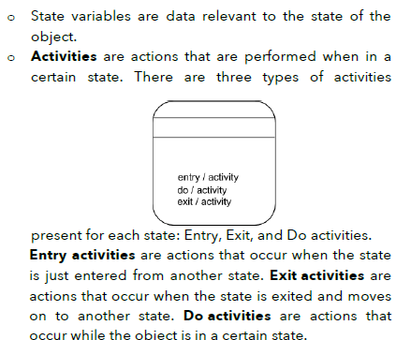
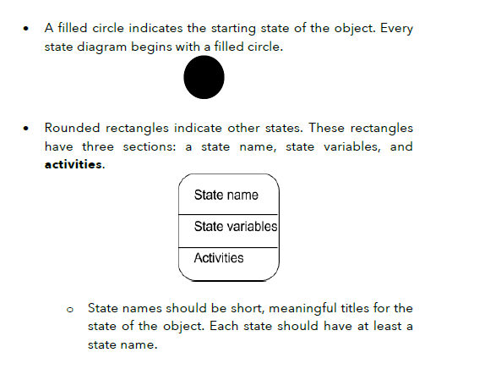
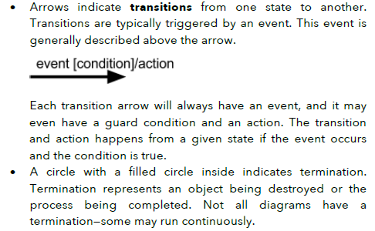
UML State Diagrams

Slide 48
Example: Car with Automatic Transmission
Example: Car with Automatic Transmission
A car can exist in different states:
  Park → Car is stationary and locked.
  Reverse → Car moves backward.
  Neutral → Car wheels are disengaged.
  Drive → Car moves forward.
Transition Example:
  If the car is in Reverse, it can only move backward.
  To move forward, the driver triggers a gear shift event, changing the state to Drive.
✅ Why Use State Diagrams?
  Clarify behavior: Easier to see how an object responds to different inputs than reading source code.
  Reveal missing cases: Helps identify unplanned conditions or transitions.
  Support testing: Knowing all possible states ensures complete test coverage.
  Better communication: Provides a shared visual language for designers, developers, and testers.

Slide 49
Model Checking
Model checking is a formal verification technique used to systematically check whether a software system behaves correctly in all its possible states.
  It explores every possible state transition of the system.
  It helps identify errors that might not be caught by traditional testing methods (unit tests, beta testing, simulations, etc.).
🔹 How It Works
Generate a State Model
  From your software (e.g., code or specification), the model checker builds a state model.
  A state model is like an abstract state machine that represents the system’s states and transitions.
Check Behavioural Properties
  The model checker verifies whether the state model satisfies specific properties, such as:
    No deadlock (system should not freeze with tasks waiting for each other).
    No race conditions (two processes accessing shared resources unpredictably).
    Certain events must always eventually occur.

Slide 50
Model Checking
🔹 Why It’s Useful Explore All States
  The model checker simulates every possible state change caused by different events and inputs.
  If a violation is found (e.g., a deadlock is possible), the tool provides a counterexample trace showing how it could happen.
Example
  Suppose a system has a rule: “No deadlock should occur.”
  The model checker simulates all possible state transitions.
  If it finds that Process A and Process B could wait forever for the same resource, it reports a deadlock violation.
✅ Finds errors not easily detected by testing.
✅ Ensures system reliability, especially in safety-critical systems (banking, aviation, medical devices, etc.).
✅ Complements other testing techniques.

Slide 51
Example: Smartphone System
Initial Design:
  Single SmartPhone class with both camera and phone functions
  Low cohesion → unrelated behaviors mixed together
  Poor modularity → cannot reuse or replace components separately
Improved Design (with SoC):
  Identify two concerns:
    Phone functionality
    Camera functionality
  Create separate cohesive classes (Phone, Camera)
  SmartPhone acts as coordinator, referencing these components
  Provides access without needing internal details

Slide 52
Thank You (Q/A)

